Slide 1
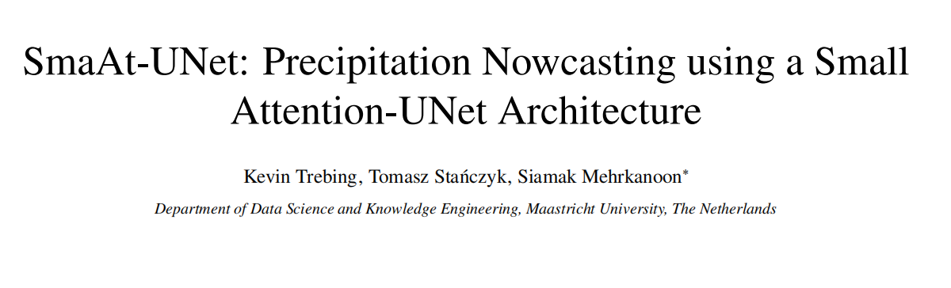
A downside of numerical weather prediction is that it is lacking the ability for short-term forecasts using the latest available information. By using a data-driven neural network approach it is possible to produce an accurate precipitation nowcast.
Propose SmaAt-UNet, an efficient convolutional neural networks-based on the well known UNet architecture equipped with attention modules and depthwise-separable convolutions.
Dataset: real life datasets using precipitation maps from the region of the Netharlands and binary images of cloud coverage of France
The experimental results show that in terms of prediction performance, the proposed model is comparable to other examined models while only using a quarter of the trainable parameters.

Slide 2
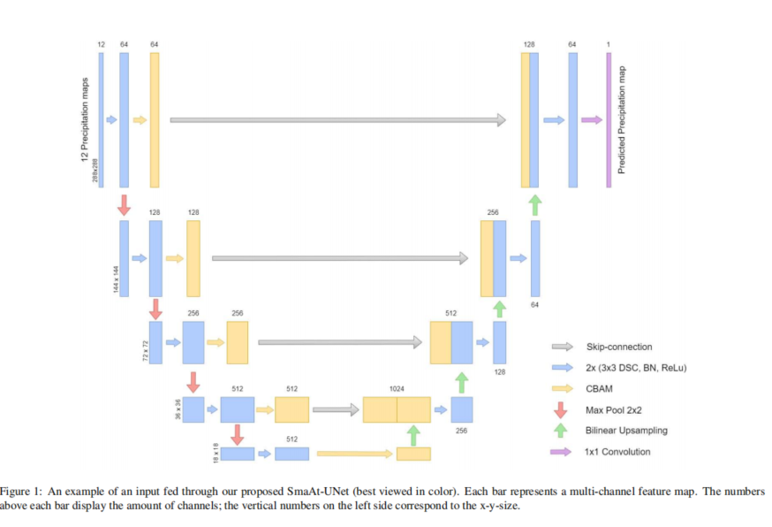

Slide 3
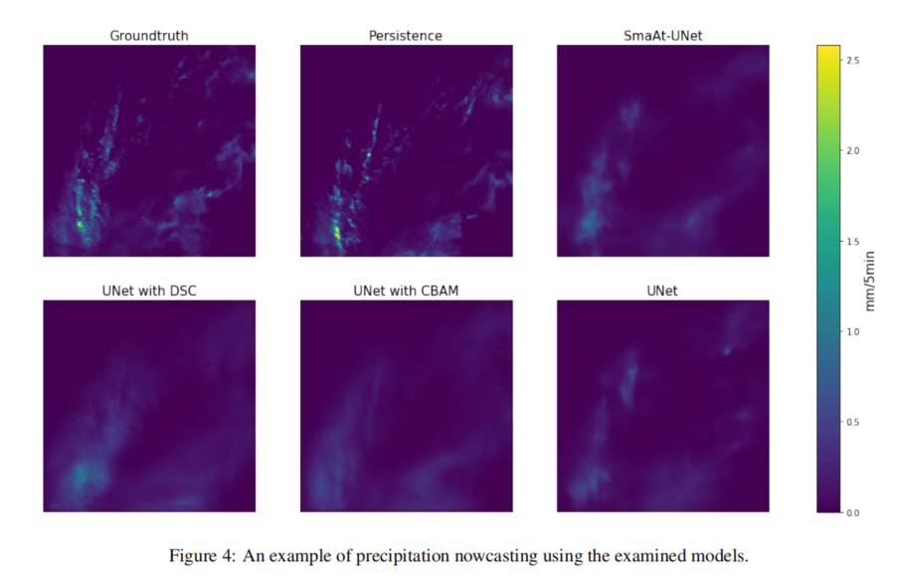
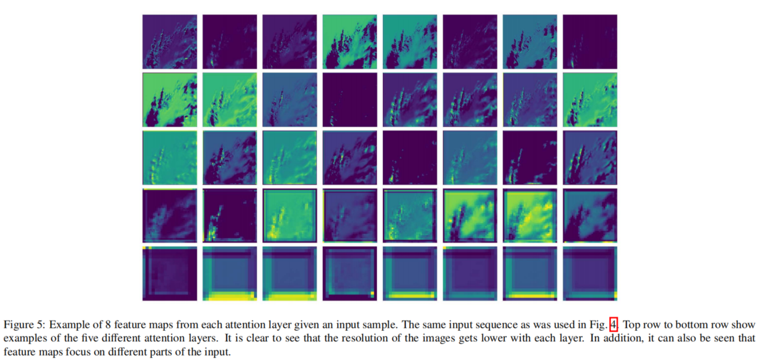

Slide 4
